Slide 1
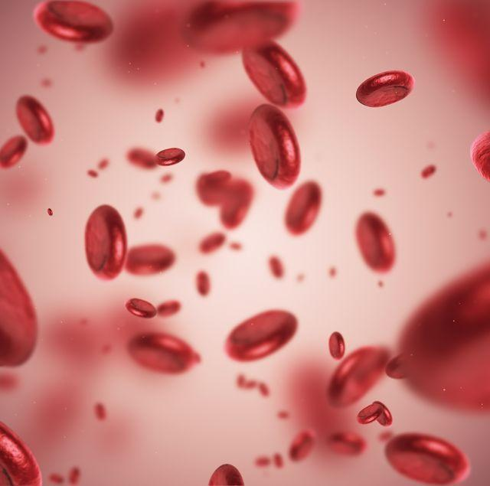
Hematological Analysis for Anemia Diagnosis
Professor: Dr. Hong Xue | Course: AIT-780-001 | George Mason University
Naga Sai Dhanya Veerepalli
Suparna Mannava
Akhila Kudupudi
Srija Anasuri

Slide 2

PROJECT AGENDA
01
Introduction and Dataset Description
02
Research Questions
03
Exploratory Data Analysis
04
Machine Learning Models
05
Summary

Slide 3
INTRODUCTION AND DATASET DESCRIPTION

Slide 4
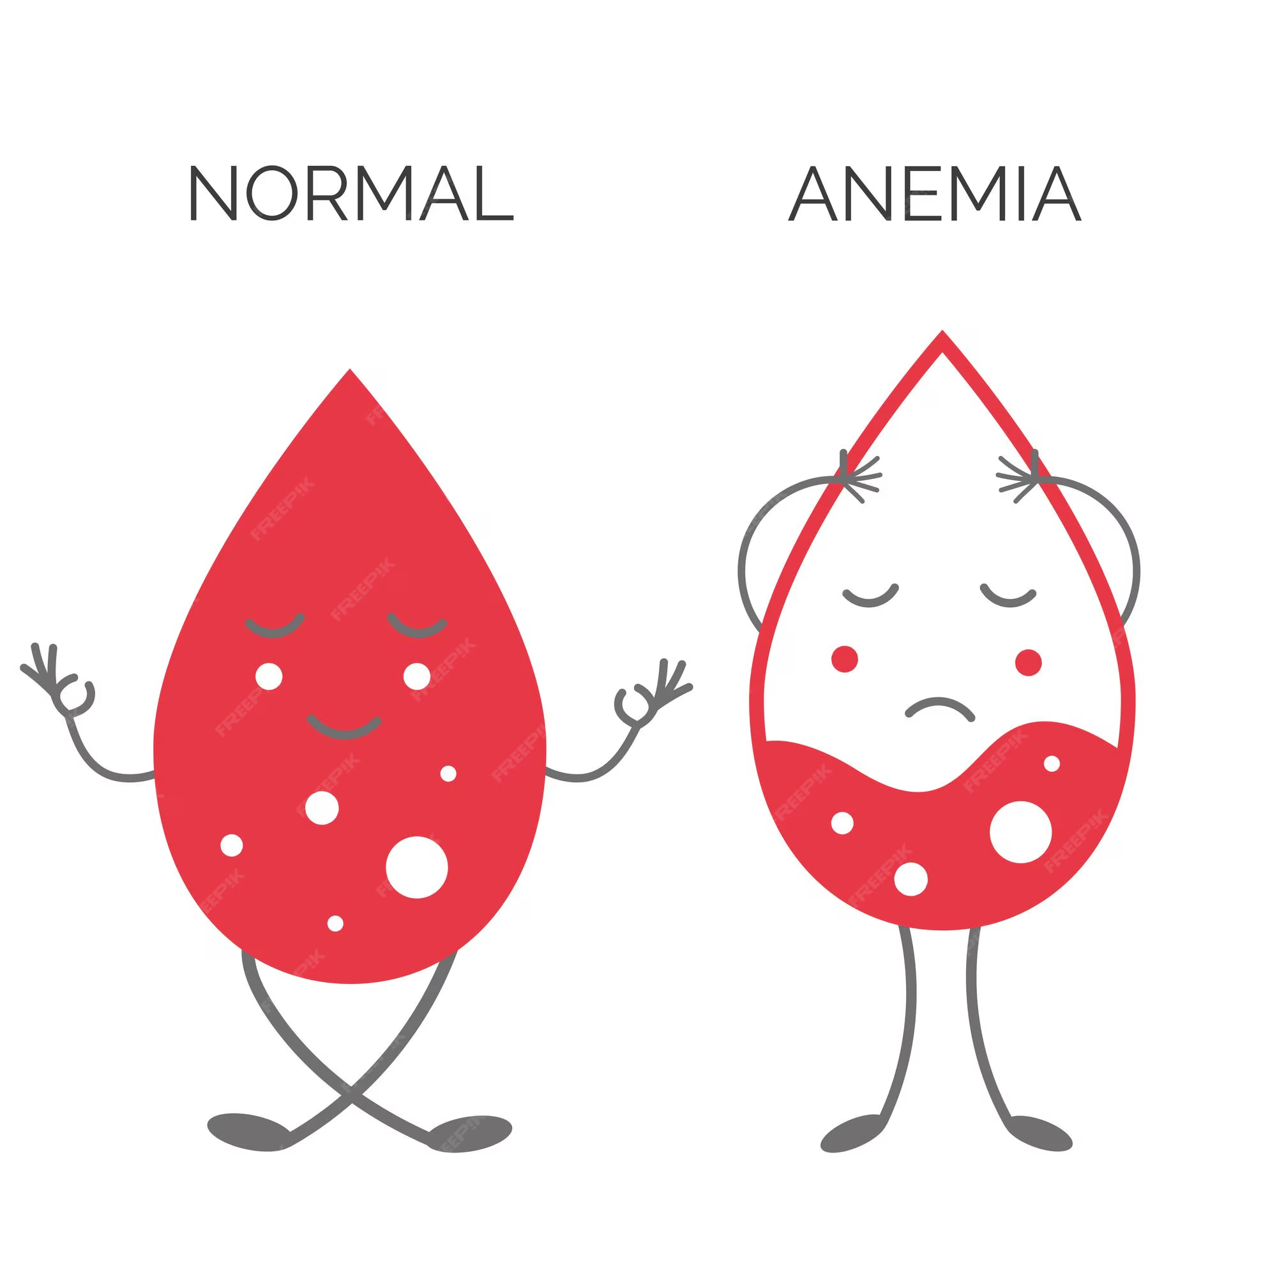
INTRODUCTION - PROJECT SIGNIFICANCE
Anemia is a widespread health condition affecting millions globally, characterized by a deficiency in red blood cells or hemoglobin. Accurate diagnosis and classification are crucial for effective treatment and management.
This project focuses on analyzing key hematological parameters, such as:
Hemoglobin (HGB)
Mean Corpuscular Hemoglobin Concentration (MCHC)
Mean Corpuscular Volume (MCV)
Using data-driven techniques like Random Forest, we identify critical features that differentiate various types of anemia, enabling a deeper understanding of the underlying patterns and relationships. The insights gained can aid in improving diagnostic accuracy and tailoring patient care. Also, different classification models can be build to accurately classify the correct diagnosis.

Slide 5

ABOUT THE DATASET
Dataset Type: Complete Blood Count (CBC) data labeled with anemia diagnosis.
Source: Collected from multiple CBC records, manually diagnosed by healthcare professionals.
Objective: To analyze key hematological parameters and classify anemia types.

Slide 6
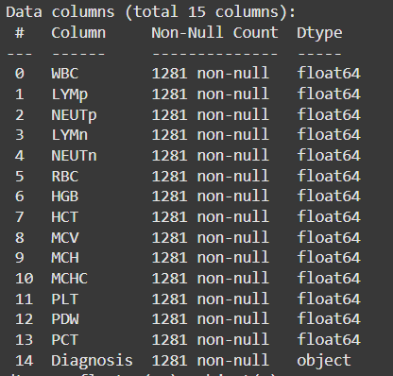
FEATURES
HGB: Hemoglobin, crucial for oxygen transport.
PLT: Platelet count, involved in blood clotting.
WBC: White blood cell count, vital for immune response.
RBC: Red blood cell count, responsible for oxygen transport.
MCV: Average volume of red blood cells.
MCH: Average hemoglobin per red blood cell.
MCHC: Concentration of hemoglobin in red blood cells.
PDW: Platelet size variability.
PCT: A marker for bacterial infections and sepsis risk.
Target Variable: Diagnosis (Anemia Type).

Slide 7
CATEGORIES OF DIAGNOSIS
Healthy: Indicates no observable health issues.
Iron Deficiency Anemia: A condition where the blood lacks enough healthy red blood cells due to insufficient iron, leading to reduced oxygen transport.
Leukemia: A type of cancer that affects the blood and bone marrow, characterized by abnormal production of white blood cells.
Leukemia with Thrombocytopenia: A condition involving an abnormally low platelet count, increasing the risk of bleeding.
Macrocytic Anemia: Red blood cells are larger than normal, often associated with vitamin B12 or folate deficiency.
Normocytic Hypochromic Anemia: Red blood cells are of normal size but have reduced hemoglobin content, leading to pale-colored cells and reduced oxygen transport.
Normocytic Normochromic Anemia: Red blood cells appear normal in size and color but are insufficient in number.
Other Microcytic Anemia: A group of anemias where red blood cells are smaller than normal, excluding common causes like iron deficiency.
Thrombocytopenia: A condition characterized by a low platelet count, which can lead to increased bleeding and bruising.

Slide 8
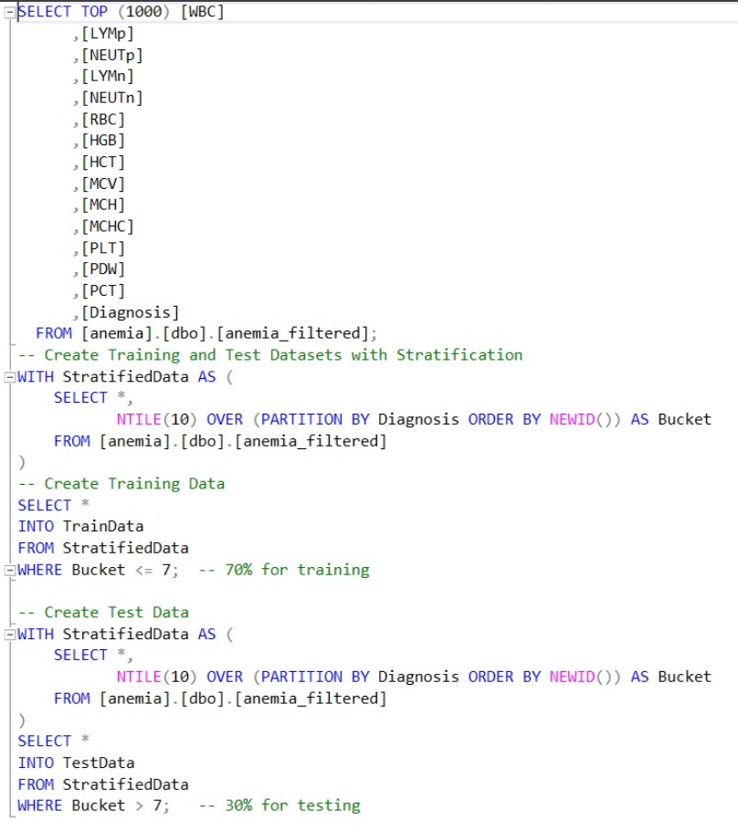
Data Splitting with Stratification: Training and Test Sets
The overall dataset contains 1,277 records after standardization, out of which:
869 records were used for the training set.
359 records were used for the test set.

Slide 9
RESEARCH QUESTIONS

Slide 10
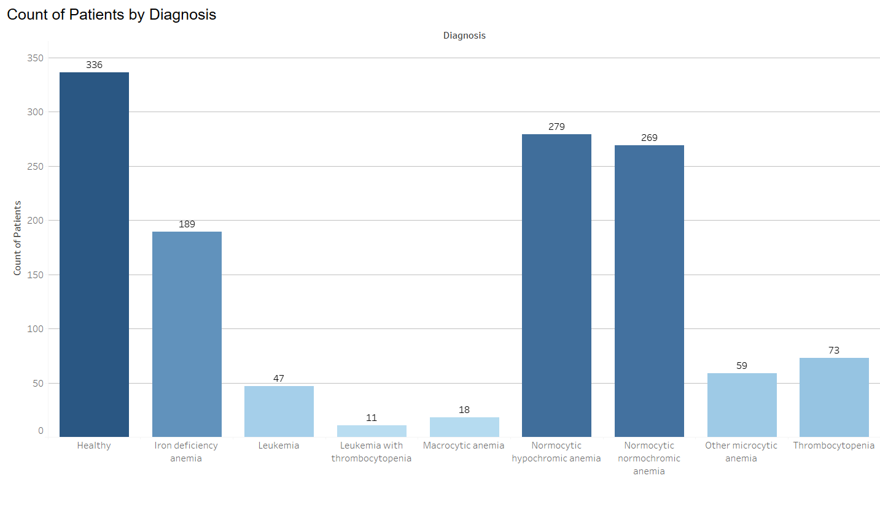
What is the distribution of patients across different types of anemia and related conditions?
The plot highlights that normocytic anemia and iron deficiency anemia are the most prevalent diagnoses among patients, while conditions like macrocytic anemia and leukemia with thrombocytopenia are relatively rare.

Slide 11
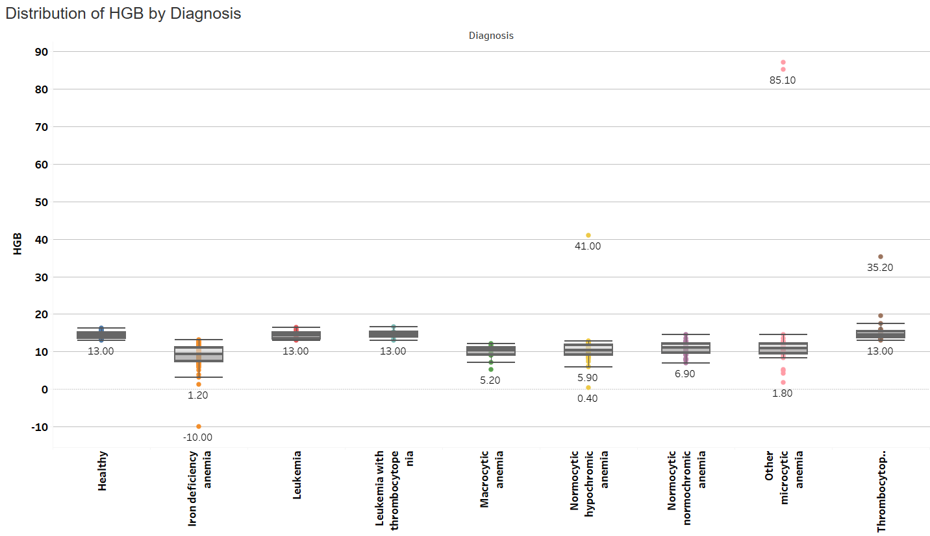
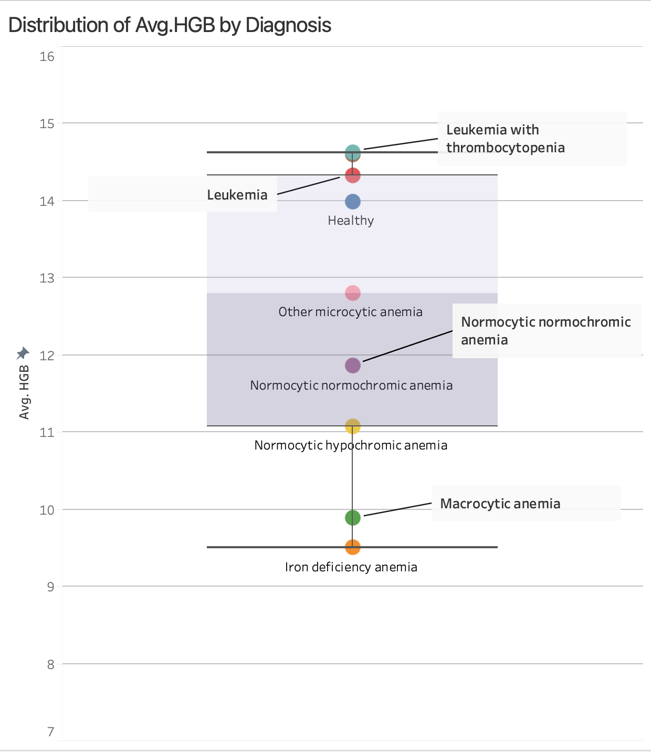
2. How do hemoglobin (HGB) levels, including their variation and averages, differ across various diagnoses, and what patterns or anomalies can be observed to distinguish between healthy individuals and anemia types?
Conditions like leukemia and macrocytic anemia showing extreme HGB values, while other types of anemia cluster around lower average levels.

Slide 12
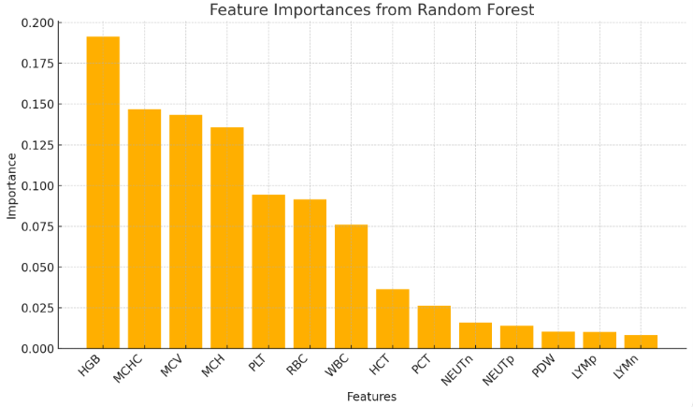
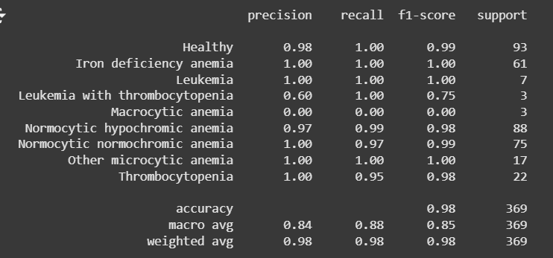
3. What are the factors that contribute to predict the different types of anemia ?
Hemoglobin (HGB), mean corpuscular hemoglobin concentration (MCHC), and mean corpuscular volume (MCV) are the most significant features influencing the Random Forest model's predictions, indicating their strong relevance in diagnosing conditions related to anemia.

Slide 13
EXPLORATORY DATA ANALYSIS

Slide 14
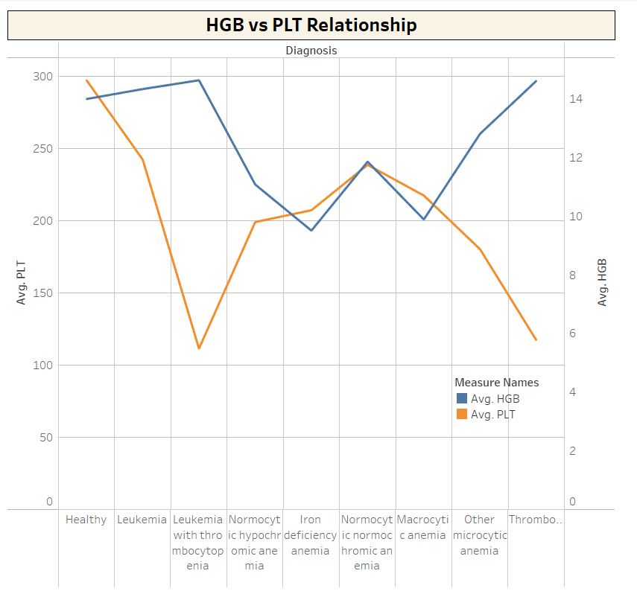
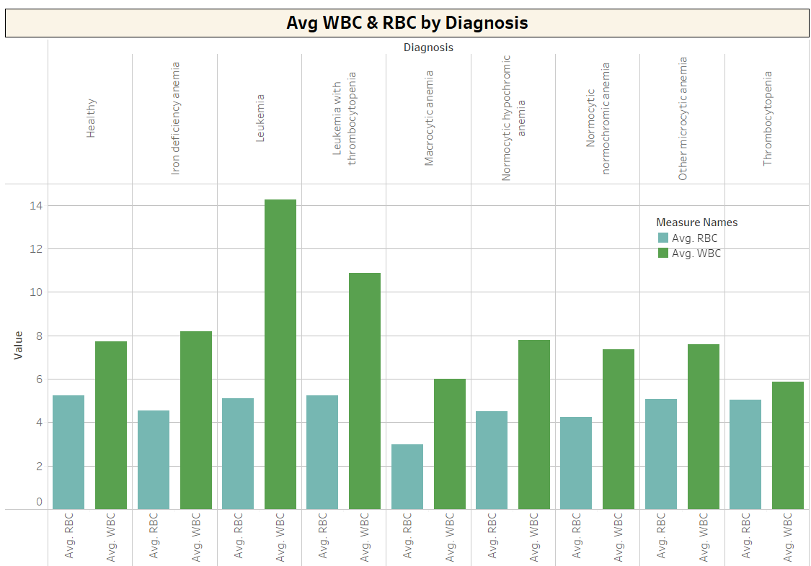
EXPLORATORY DATA ANALYSIS
This plot highlights the relationship between average hemoglobin (HGB) and platelet (PLT) levels across different diagnoses, revealing distinct trends and variations between conditions.
This bar chart compares the average white blood cell (WBC) and red blood cell (RBC) counts across various diagnoses, emphasizing significant differences in leukemia and related conditions.

Slide 15
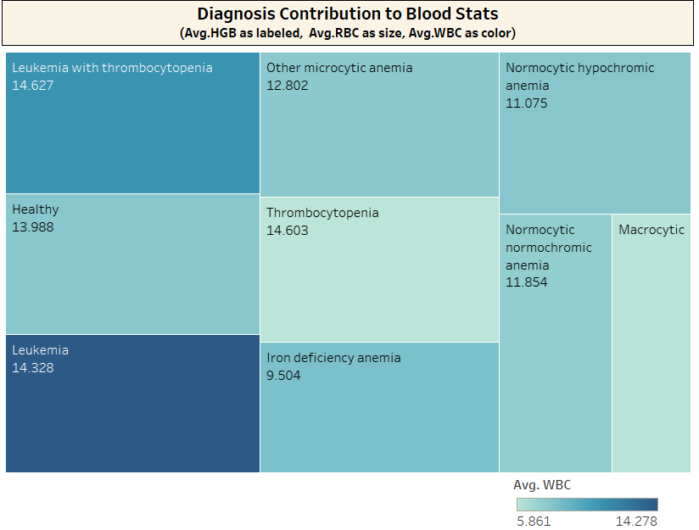
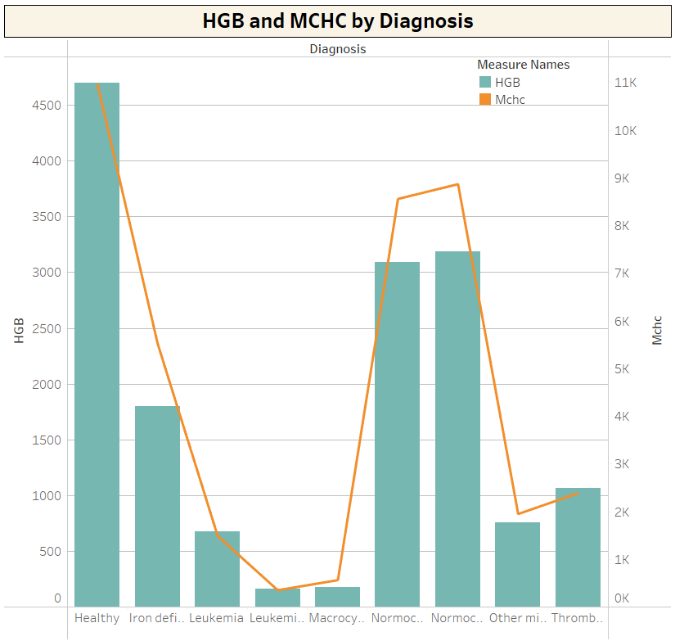
EXPLORATORY DATA ANALYSIS
This treemap shows the contribution of average HGB (as labels), RBC (as size), and WBC (as color intensity) for each diagnosis, emphasizing the variations in blood parameters among different conditions.
This plot illustrates the variation in hemoglobin (HGB) and mean corpuscular hemoglobin concentration (MCHC) levels across different diagnoses, highlighting significant differences between healthy individuals and anemia patients.

Slide 16
MACHINE LEARNING MODELS USING WEKA

Slide 17
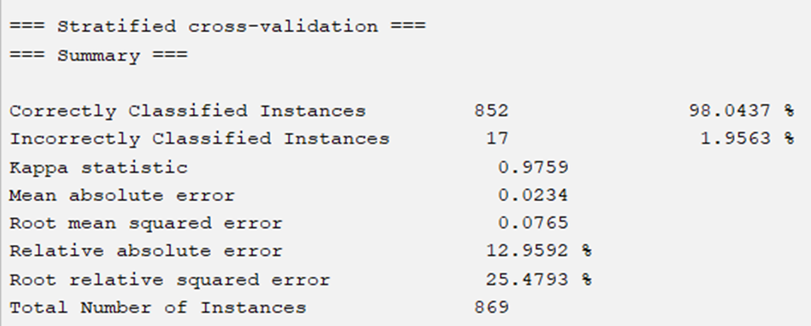
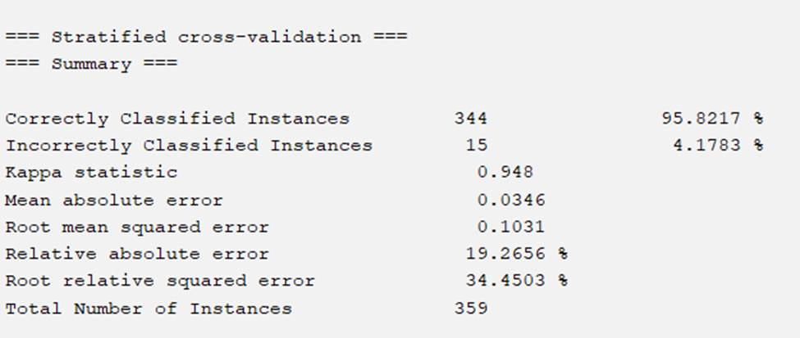
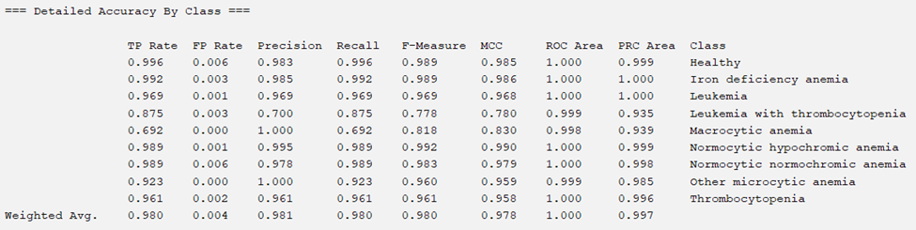
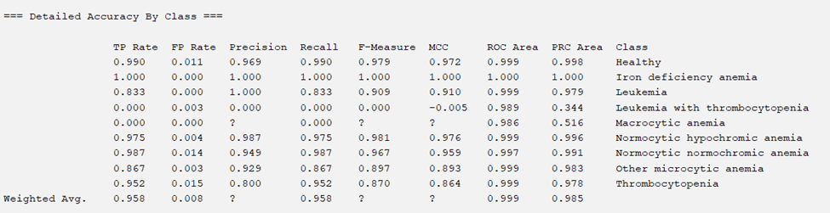
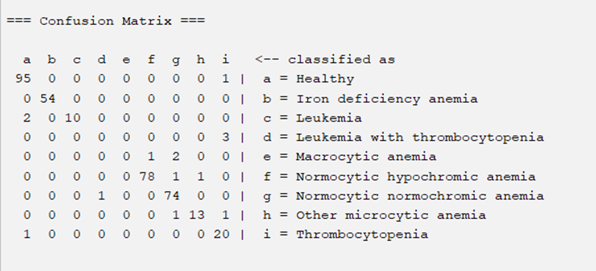
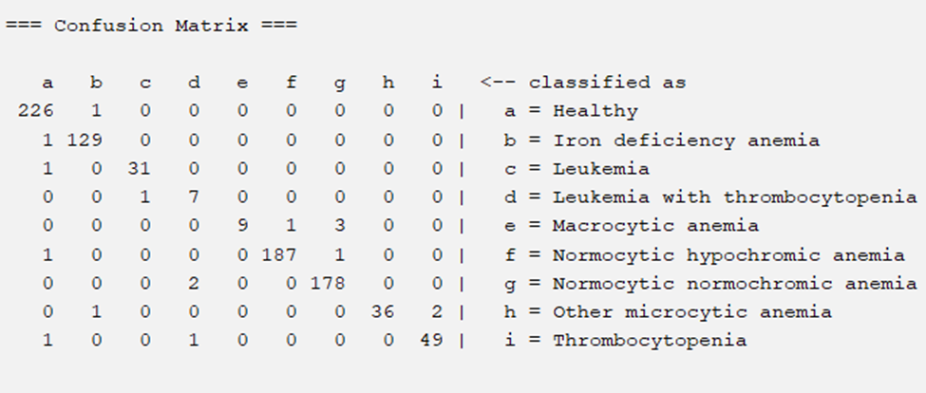
Train Set
RANDOM FOREST
Test Set

Slide 18
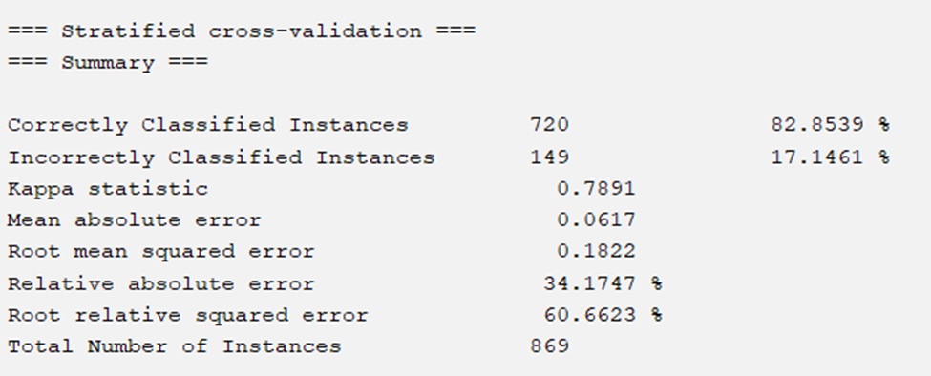
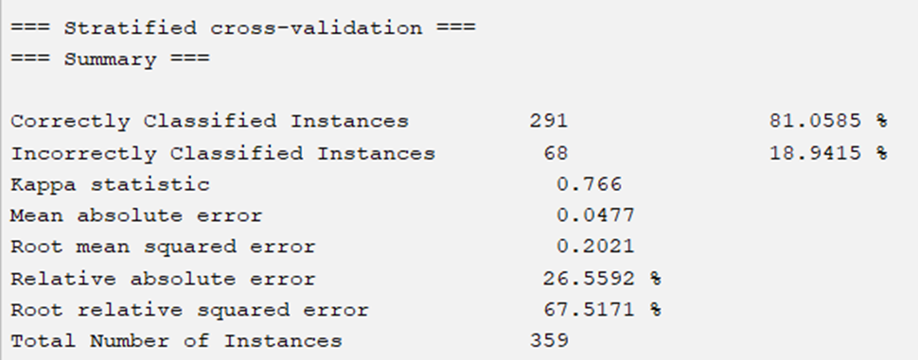
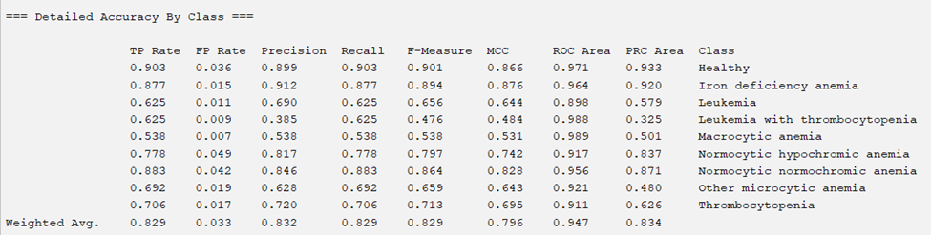
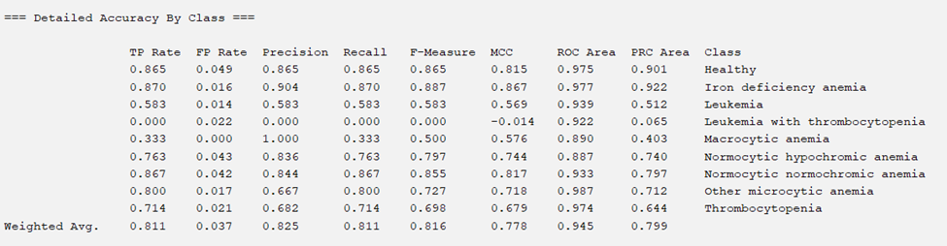
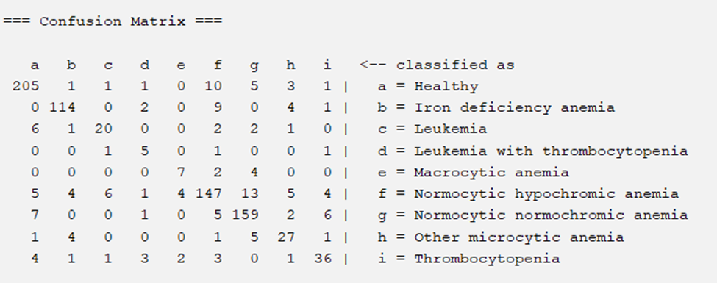
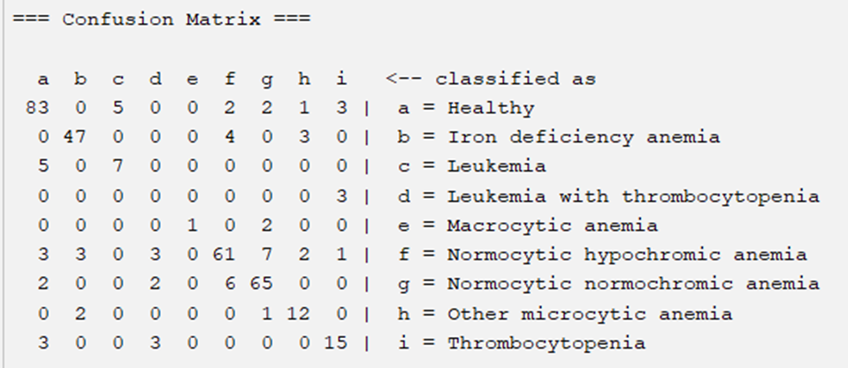
Train Set
LOGISTIC REGRESSION
Test Set

Slide 19
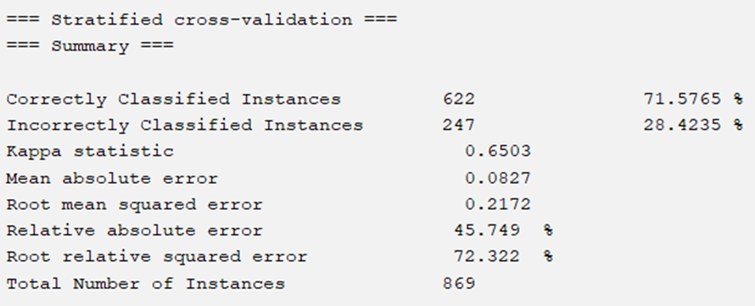
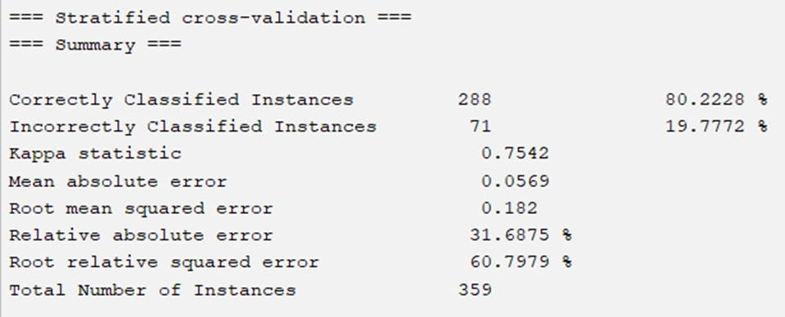
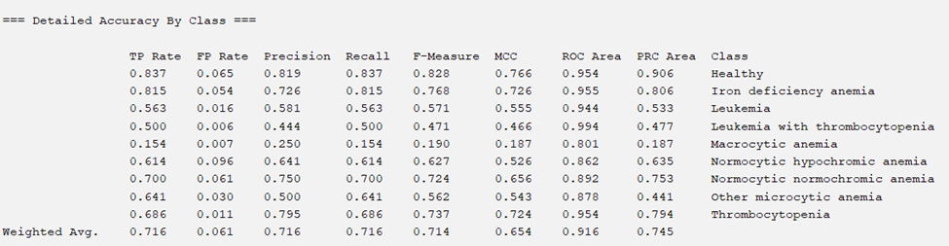
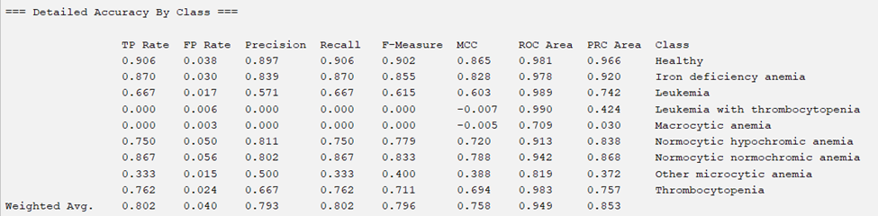
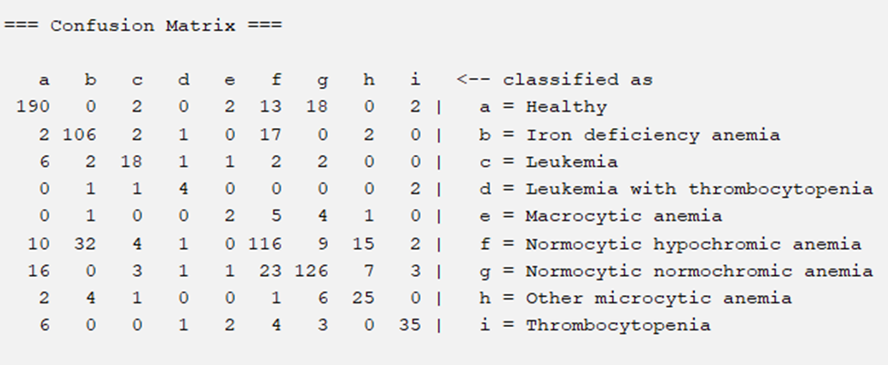
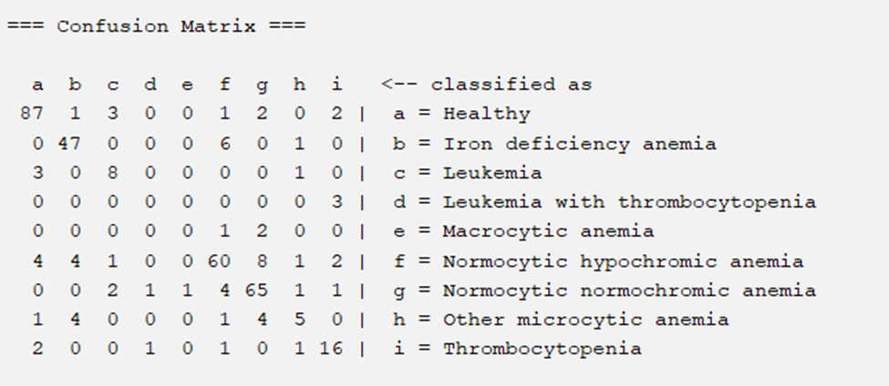
Train Set
Multilayer Perceptron (5-Fold Cross-Val.)
Test Set

Slide 20
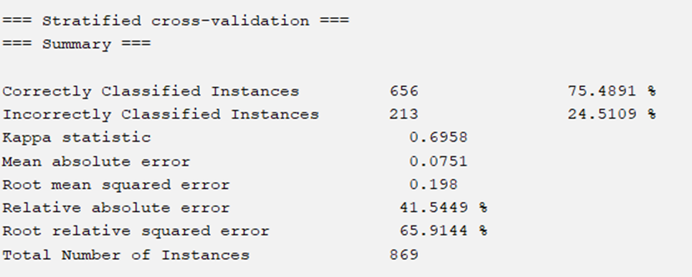
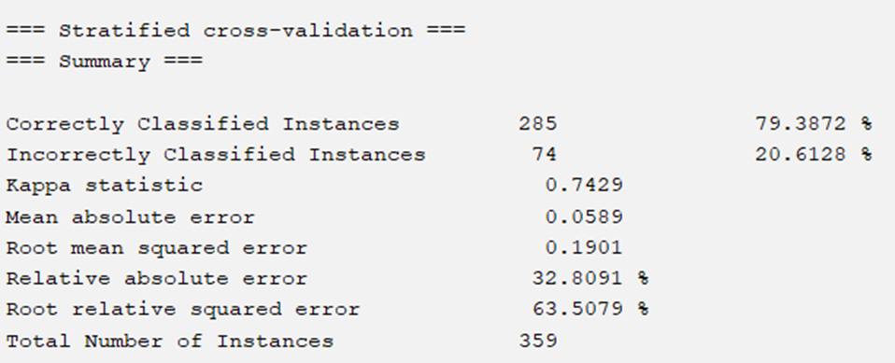
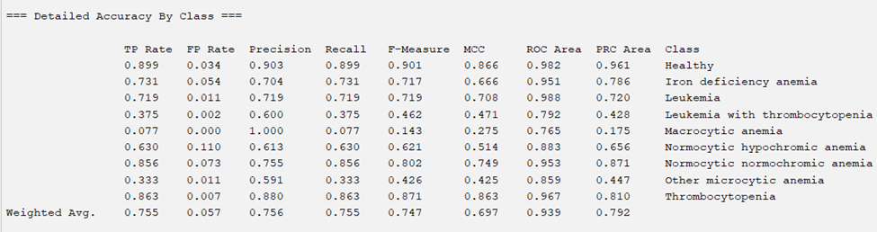
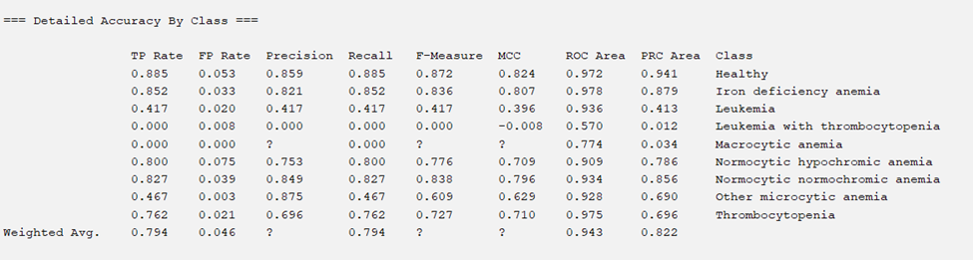
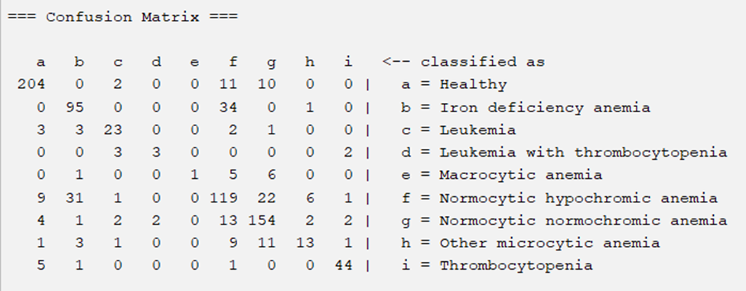
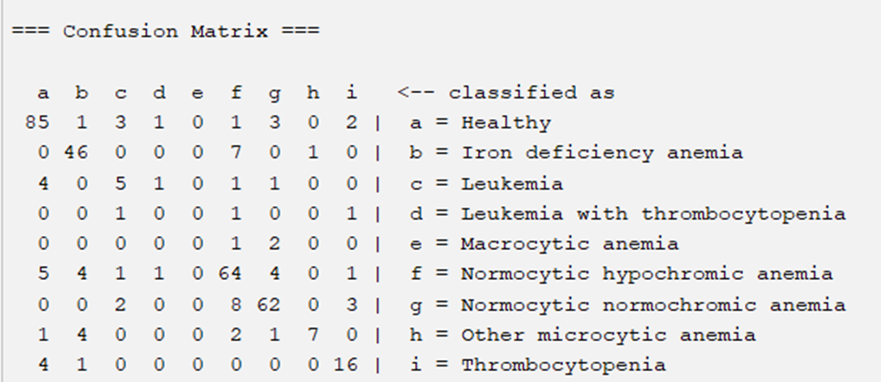
Train Set
Multilayer Perceptron (10-Fold Cross-Val.)
Test Set

Slide 21
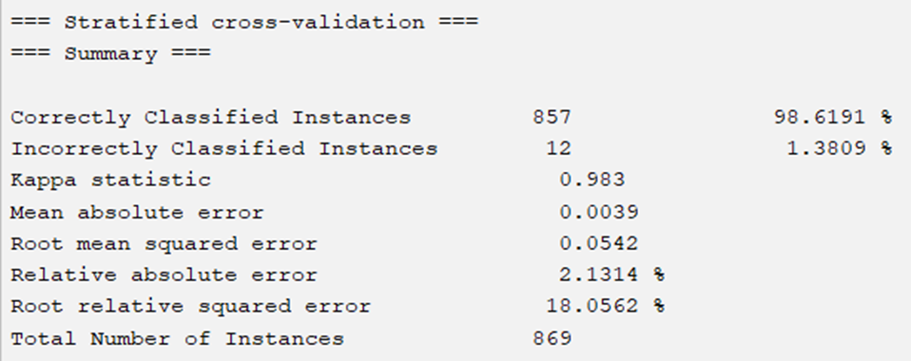
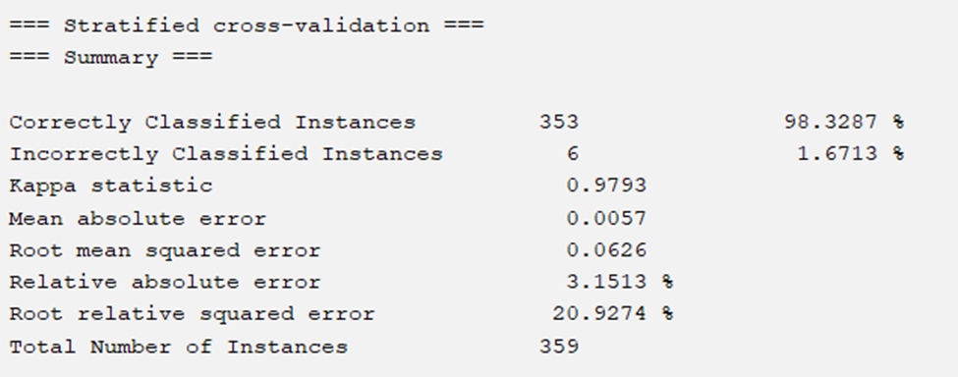
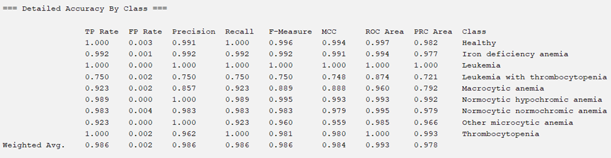

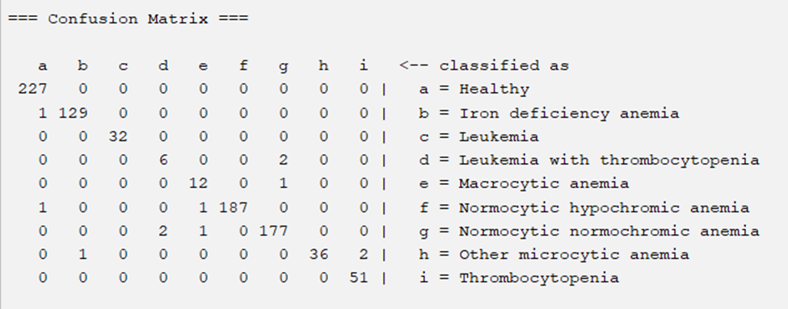
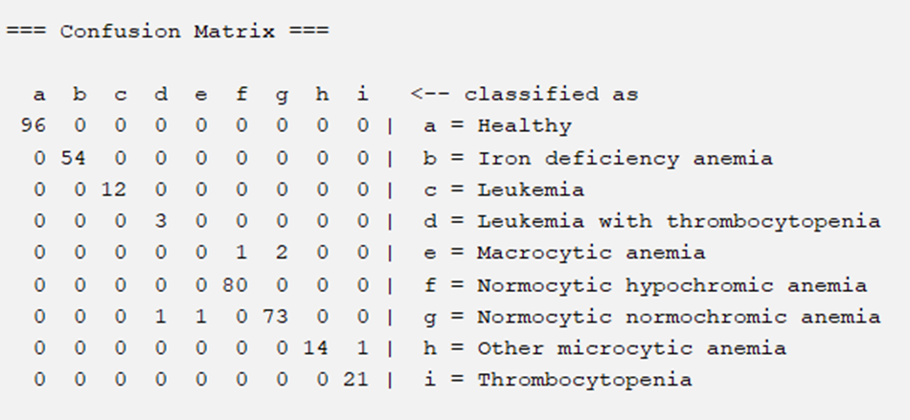
Train Set
J48 DECISION TREE
Test Set

Slide 22
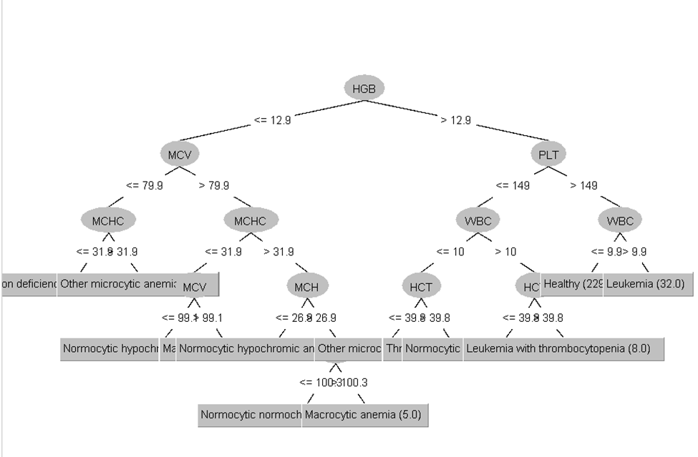
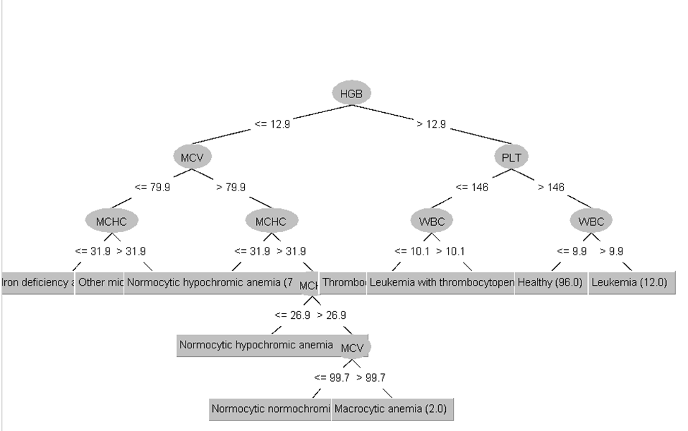
J48 DECISION TREE
Train Set
Test Set

Slide 23
Model Evaluation & Results
Model
Training Accuracy
Test Accuracy
Remarks
1
Random Forest
98%
95%
Best overall performance; high accuracy and generalization capability.
2
Logistic Regression
82%
81%
Moderate accuracy; suitable for simpler datasets or less complex patterns.
3
Multilayer Perceptron (5-Fold Cross-Val.)
71%
80%
Decent test accuracy, but low training accuracy suggests underfitting.
4
Multilayer Perceptron (10-Fold Cross-Val.)
75%
79%
Slight improvement over 5-fold; good for datasets with non-linear patterns.
5
J48 Decision Tree
98%
98%
Excellent accuracy; may risk overfitting due to complex tree structures.

Slide 24


CONCLUSION
Hemoglobin levels can be a primary factor to check while diagnosing different anemic types followed by other factors.
J48 trees machine learning models can be used to classify the different anemic conditions due to its high classification accuracy.

Slide 25
REFERENCES
https://www.kaggle.com/datasets/ehababoelnaga/anemia-types-classification
https://www.healio.com/news/hematology-oncology/20120331/defining-and-recognizing-different-types-of-anemia-common-to-the-oncology-practice?gclid=EAIaIQobChMIrcymtI-MigMVhHNHAR0glg9wEAAYASAAEgKz9vD_BwE
https://vciba.springeropen.com/articles/10.1186/s42492-024-00169-4

Slide 26
THANK YOU!!!

